Slide 1


Children’s Mental Health Week
1-7 February 2021
Assembly slides for secondary-age young people

Slide 2
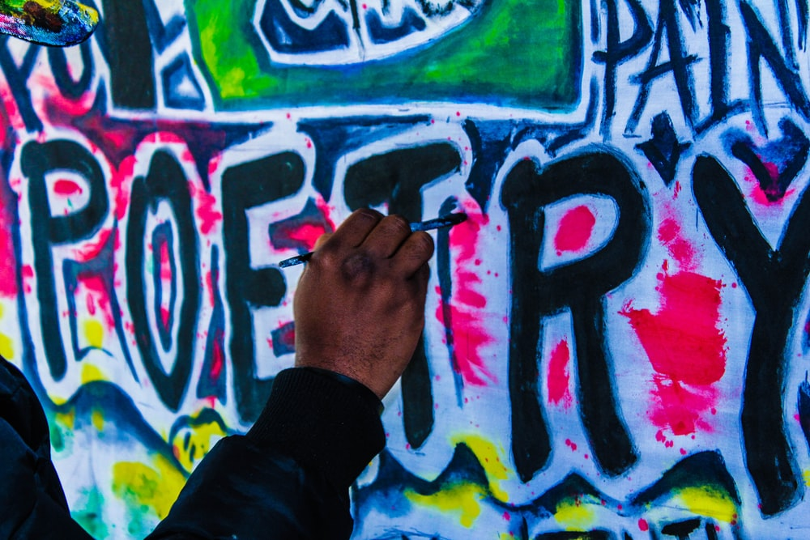

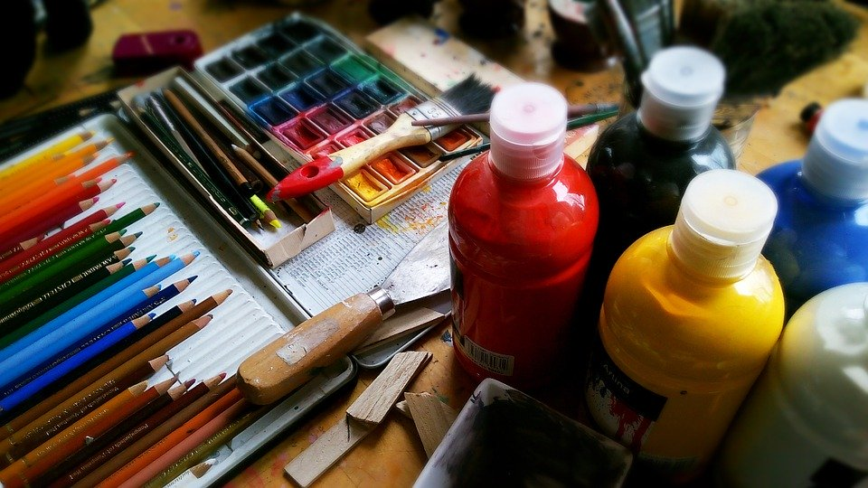

Slide 2
“Express yourself” is about finding creative ways to share feelings, thoughts, or ideas…
…through things like art, writing, music, dance and
doing things that make you
feel good.

Slide 3
Slide 3
Being creative and expressing yourself can:
help you to relax and de-stress
generate “feel-good” endorphins which can lift your mood, help you feel empowered, and create a sense of identity and achievement
help to boost your self-esteem, connect with others, and give you purpose and meaning
How does society often expect young people to look, think, speak and act? And where do these ideas come from?
Do these expectations stop you from expressing your true self?
How does that make you feel?

Slide 4

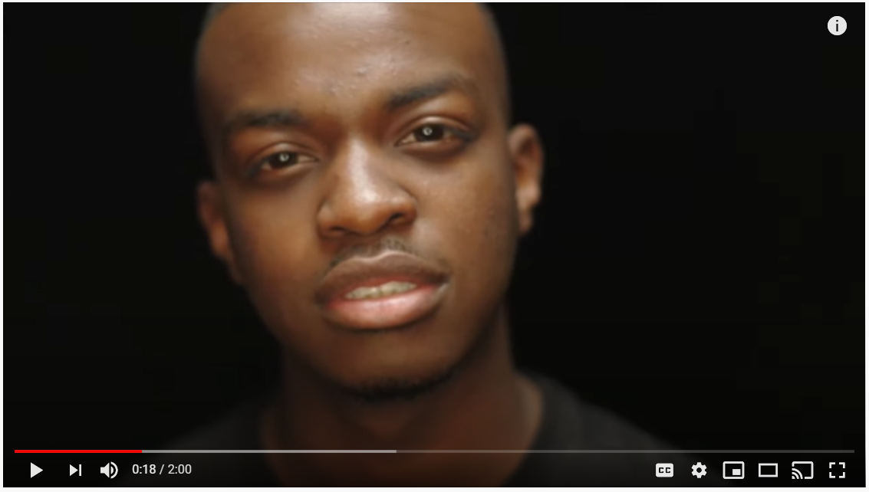
Slide 4
Watch this spoken word piece by George the Poet on the theme of possibilities
Discuss the possibilities
for each of us to explore our own creativity this Children’s Mental Health Week.

Slide 5



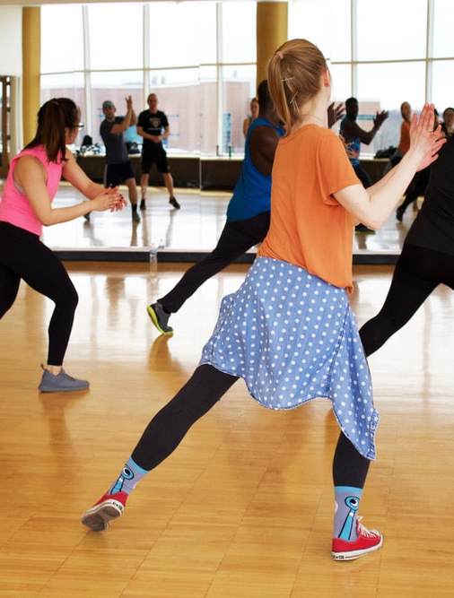
Slide 5

Slide 6
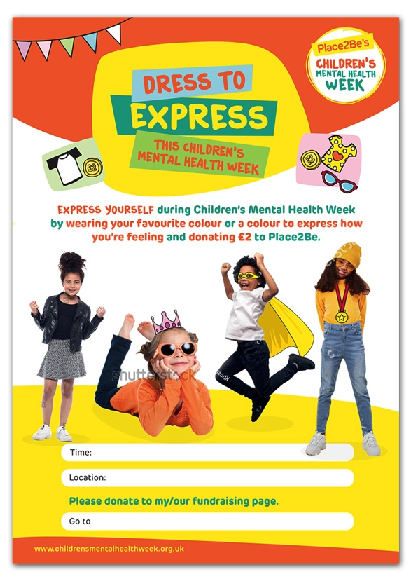

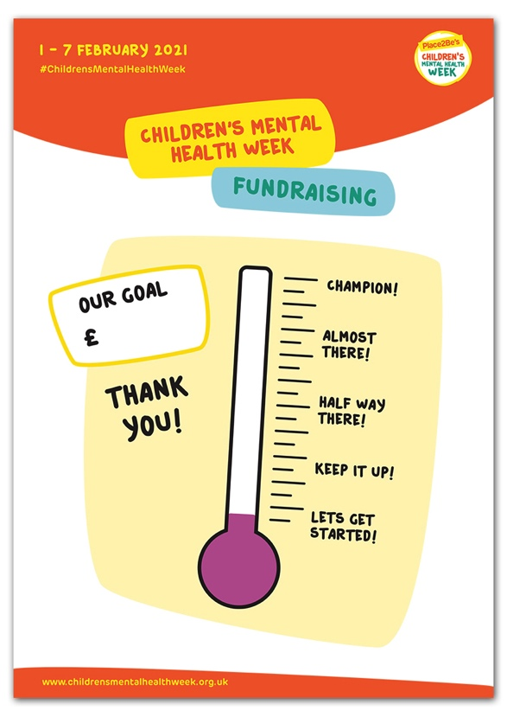
Slide 6

Slide 7

All images in this presentation are royalty free from unsplash.com, pixabay.com and canva.com
George the Poet’s spoken word piece was shared by Random Acts - Channel 4's home for creative short films.

