Slide 1




Assembly guide for primary schools 2027
KS2, P4, P5-P7 (Scotland)
Notes:
Aim: To introduce children to the idea of Step Into Our World
You will need: Laptop / projector, story book to read

Slide 2


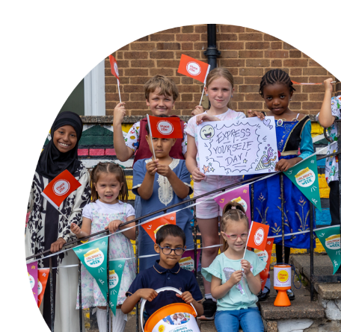

Hello and welcome
Slide 1
Notes:
Suggestions of songs to play as children are coming into Assembly which some children and young people suggested:
Some Music suggestions from our CYP:
“You’ve Got a Friend in Me” – Randy Newman
“Count on Me” – Bruno Mars

Slide 3

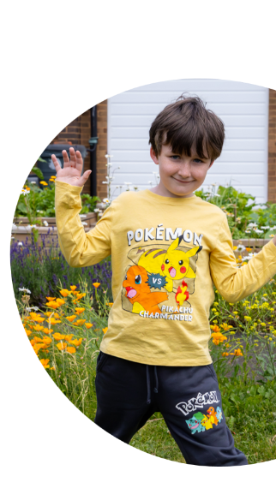


Today’s assembly has been inspired by Place2Be’s Children’s Mental Health Week. The theme this year is ‘Step into Our World’ which is all about empathy and understanding how someone else is feeling.
Slide 2

Slide 4



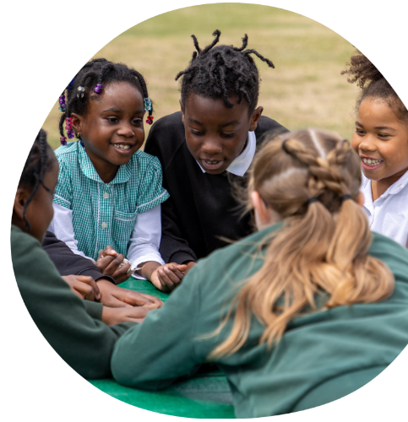

SO WHAT DOES EMPATHY MEAN?
Slide 3
Notes:
Ask the children to raise their hands.

Slide 5


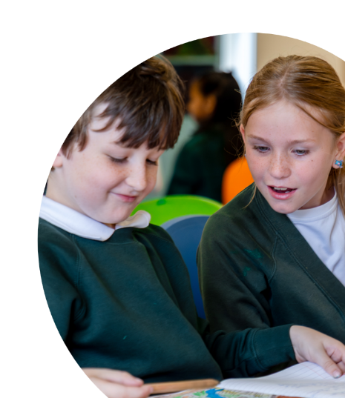



WHAT IS EMPATHY?
Empathy means being able to step into someone else's world and understand what they might be feeling.
Slide 4

Slide 6



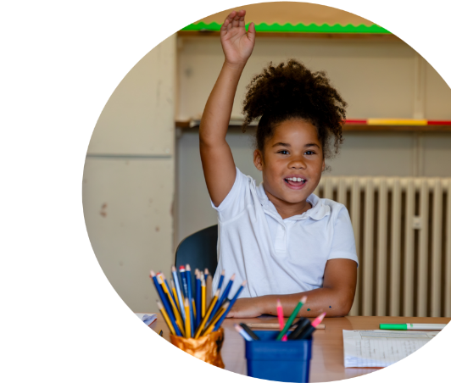
TOP TIPS FROM SOME YOUNG PEOPLE ON HOW TO ​SHOW EMPATHY
This is what some of you had to say!​
“Try to understand you rather than try to immediately try ​to search for an answer”​
“Be patient”
“To ask if you are ok”​
Slide 5

Slide 7






A FEW IDEAS FROM PLACE2BE
Be Curious
we are all different and so sometimes what you might think about someone might not be the same until you talk to them. ​
Listen
to what someone is saying to you so you can understand how they might be feeling.
Imagine
putting yourself in someone else’s shoes - how or what would you feel.
Slide 6

Slide 8



STORY: A NEW FRIEND IN CLASS
Mila's First Day
Today is Mila's first day at school. She doesn't know anyone in the class. At playtime, she stands quietly by herself and watches the other children playing together.
Sam notices Mila is looking sad and wonders what might be wrong. Then he thinks how he would be feeling if it was his first day at a new school.
So, he walks over to Mila and asks "Would you like to play with us?" Mila smiles and joins the game.
Discussion Questions
How do you think Mila felt when she arrived at school?
What clues tell us how she was feeling?
How do you think Mila felt when Sam invited her to play?
Slide 7

Slide 9


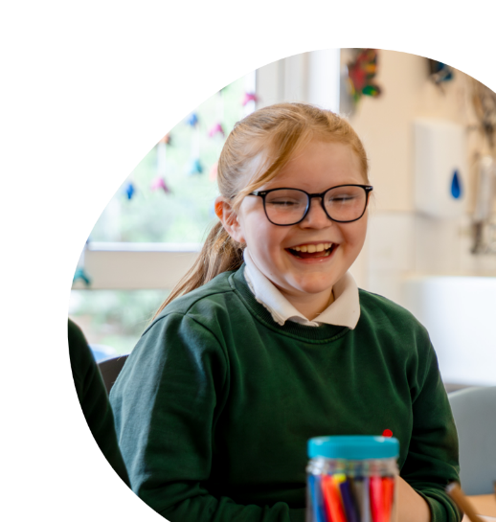

LET'S PRACTICE
Emotion detective!
Turn to the person next to you and say your name clearly.
Tell them what makes you feel happy.
Swap so they say their name and what makes them feel happy to you.
Now you can report what makes that person feel happy.
Slide 8

Slide 10


LET'S SING
Play and sing along to our chosen song below or one that you or the children have chosen or you can use this to enter / exit from the assembly.
This Is Me – The Greatest Showman
Try Everything – Shakira
You’ve Got a Friend in Me – Randy Newman
Slide 9

Slide 11



CALL TO ACTION
This week, can you:
👂 Listen carefully when someone is talking.
😊 Notice how others might be feeling.
🤝 Include someone who is on their own.
💬 Use kind words to help someone feel better.
❤️ Stop and think: "How would I feel if that happened to me?"
Slide 10

Slide 12



CLOSING:
Remember we don't always know how someone else is feeling. Empathy means taking a moment to understand another person's experience and thinking about how we can help.
Thank you

