Slide 1
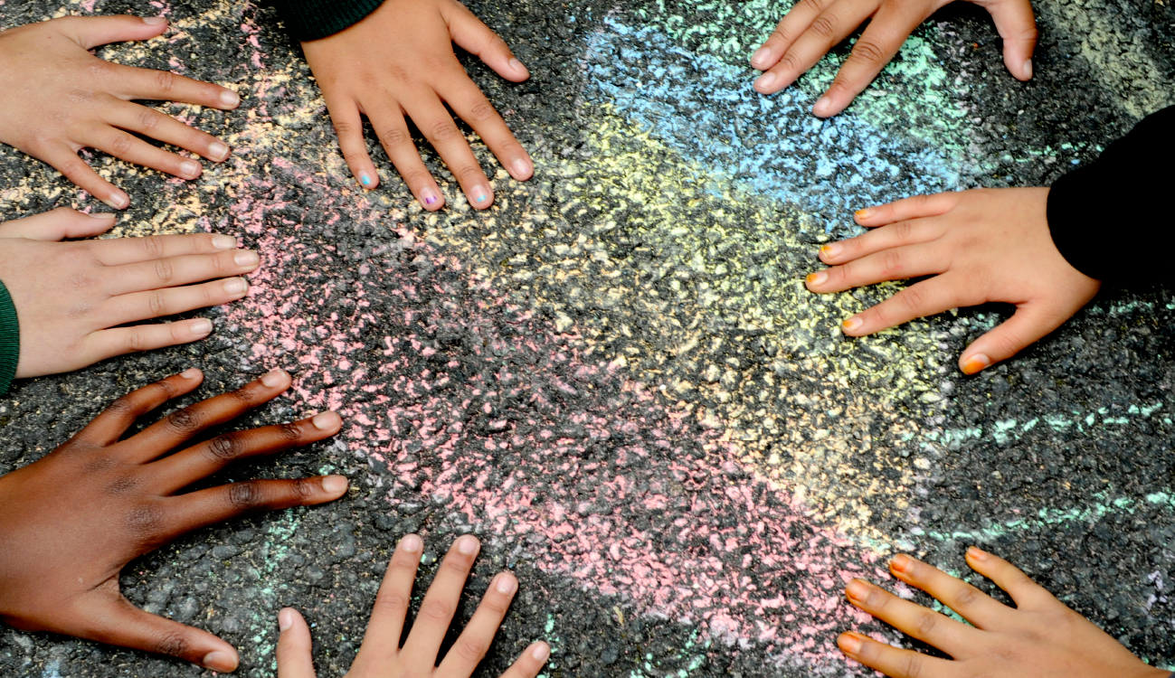






Assembly guide for secondary schools 2026
Notes:
Aim: To encourage students to consider how This is My Place and their sense of belonging can be used to make a difference.
You will need: Laptop / projector

Slide 2



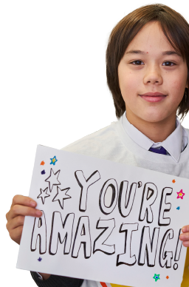


WELCOME
Notes:
Notes for Teachers:
Music playing as everyone comes in and quotes appear:
Some Music suggestions from our Young People:
”Hello Me and You” https://www.youtube.com/watch?v=g9dVcZQBUdA
“We are Going to be Friends” White Stripes https://www.youtube.com/watch?v=PKfD8d3XJok
“You Belong with me” Taylor Swift https://www.youtube.com/watch?v=VuNIsY6JdUw
“This is Me” The Greatest Showman https://www.youtube.com/watch?v=CjxugyZCfuw
“We are Family” Sister Sledge https://www.youtube.com/watch?v=uyGY2NfYpeE
“The Lakes” Taylor Swift https://www.google.com/search?gs_ssp=eJzj4tVP1zc0zDZLj0usrQwYPQSK8lIVchJzE4tVihJrMzJL1IoLs9MKwEA7v8M_g&q=the+lakes+taylor+swift&rlz=1C1GCEA_enGB904GB904&oq=The+lakes+taylor+swift&gs_lcrp=EgZjaHJvbWUqBwgBEC4YgAQyCggAEAAY4wIYgAQyBwgBEC4YgAQyBwgCEAAYgAQyBwgDEAAYgAQyBwgEEAAYgAQyBggFEEUYPDIGCAYQRRg9MgYIBxBFGD3SAQg2NTM3ajBqN6gCALACAA&sourceid=chrome&ie=UTF-8
“In my place” Coldplay https://www.youtube.com/results?search_query=In+my+place+-+Coldplay.+
“Where I belong” Kevin Quinn https://www.youtube.com/watch?v=z2OGCpIZFZo
“Count on me” Bruno Mars https://www.youtube.com/watch?v=6k8cpUkKK4c
“You'll Never Walk Alone” https://www.youtube.com/watch?v=OV5_LQArLa0

Slide 3


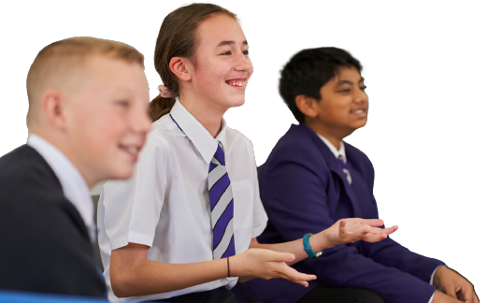

Today’s assembly has been inspired by Place2Be’s Children’s Mental Health Week. The theme this year is ‘This is My Place’ which is based around belonging and how we can feel a sense of belonging and help others feel like they belong.

Slide 4
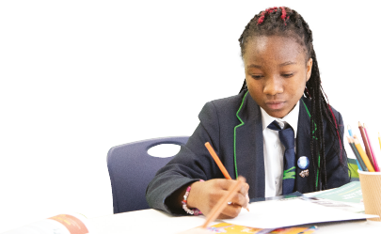
Quotes from our young people around the UK about what
belonging means to them. What does belonging mean to you?
This is what some of you had to say!
‘It’s like a place, your home, you belong with your family and friends’
‘Feeling that you have a place where you are always welcome and valued as either
place or set of people’
‘Feeling included, not left out’
‘Belonging means feeling a connection with something, feeling like I am
meant to be there with no stresses or worries. It's all about feeling safe.’
‘Feeling a part of something e.g. A group or society ’
‘Feeling like there are people similar to you as well as different.’
‘Feeling like you fit in and feeling comfortable’
‘It means that I feel happy and included where I am’

Slide 5
SO WHAT IS BELONGING?
Belonging is emotional safety.
It’s the knowledge that you can be yourself without being judged.
Belonging is participation.
It’s having access to activities, conversations, decisions, and rituals that shape the group.
Belonging is recognition.
It’s being known for who you are and having that matter to others.
Belonging is not the same as fitting in. Fitting in asks you to change to
match the group. Belonging asks the group to change so you can be yourself.

Slide 6

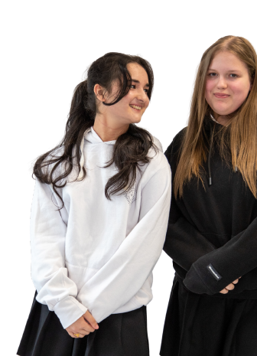
STORY
  Imagine arriving here on your first day. You know no one. You stand in the hall holding your timetable and watch groups talking, laughing, moving like a tide you can’t join. For hours you walk between classes feeling invisible. Then someone asks, “Are you okay?” They show you where to go, introduce you to a friend, and later you sit with them at lunch. The feeling that follows is immediate and powerful. That single small action turns a day of fear into a day of possibility.
Notes:
SUGGESTED STORY
(you may have your own or a story from one of the children)

Slide 7
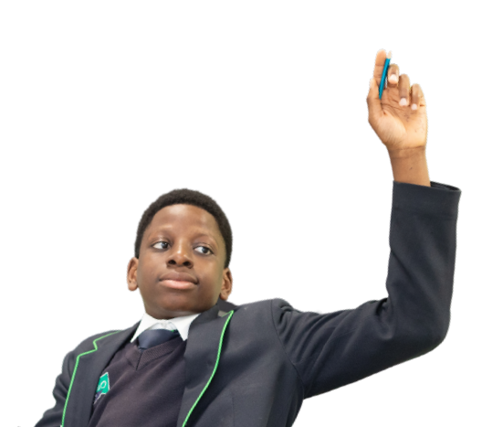
WHY BELONGING MATTERS
Adolescence is when identity is being built. Belonging gives people permission to try new things and fail without being crushed.
Young people who feel they belong are more likely to engage in learning, take healthy risks, and reach out for help when they need it.
Exclusion creates loneliness, anxiety, and can push people toward harmful behaviours and ideologies simply to stop feeling alone.

Slide 8

WE WILL ALL HAVE HAD TIMES WHEN WE
FELT WE BELONGED AND TIMES WHEN WE DIDN’T.
How can we help ourselves to feel we belong?
Top tips from other young people
‘Finding a place where you feel valued and welcome or people that make you feel this way’
‘By engaging in activities that you enjoy’
‘Try and make friends’
‘Have an adult to talk to when not happy’
‘Spending time with friends.’
‘By being more kind to people and pushing yourself outside of your comfort zone to try new things and meet more people.’
‘By talking to people about feelings.’
‘Being around people you enjoy being with’
Notes:
Can we think of any more?
Option for hands up and to take some answers
Have big bits of paper/a place and post its for young people to write/draw their ideas on and stick them on the paper
Run this exercise outside of assembly and display their ideas before or after the assembly

Slide 9

A FEW IDEAS FROM PLACE2BE:
Practice self-compassion.
When you make a mistake or feel like you've failed, be kind to yourself. This helps build resilience and reminds you that your worth isn't about being perfect.
Be authentic.
Rather than trying to "fit in", focus on being your true self. Belonging comes from being accepted for who you are.
Follow your interests.
Join clubs or groups you enjoy. Whether it's sport, video games, music, or art, shared interests is a great way to connect with others.
Embrace your uniqueness.
Think about your strengths and qualities. Don't be afraid to be different. Feeling comfortable with what makes you unique is key to building self-confidence.
Listen to yourself.
Pay attention to your feelings and try to understand what you need. For example, if you're feeling lonely, listen to this and think about what might help you feel more connected.
Talk with and be with trusted people, to support you.
This can help you feel a greater sense of belonging and support you when you don’t feel this way.

Slide 10
HOW CAN WE HELP OTHERS FEEL THAT THEY BELONG?
Helping others feel they belong
Top tips from our young people:
Be kinder and help them feel included.
Talk to them, ask them
what would make them feel like they belong, leave them alone if they want to be left alone, but do some things with them. Make sure your day doesn't revolve around everyone else belonging, though.
Introduce them to fun activities where they can meet new people and find new interests.
Talk to new people in clubs and classes. I always try to do this.
By asking people how they are and if they are okay.
Being there to support someone so they don’t feel like they're on their own.
By supporting others and
showing an interest, by being kind and not bullying others, include and invite others. Understand others, if they are new be a buddy to show them around school and keep them company at break and lunch.
Putting yourself in others' shoes.

Slide 11
Making sure that everyone feels they belong is very important to us at this school.
Some young people at Place2Be schools thought of some ideas of what schools could do to help them feel they belong. Here are a few examples:
TOP TIPS FROM OUR YOUNG PEOPLE:
Making a comfortable, welcoming place that anyone can use whenever.
Creating
activities to help
us engage with others and establish friendships.
Make us feel important and included
Be happy, friendly and welcoming
Ask students if they are ok
They can enhance belonging by asking questions when they see a child becoming passionate about something.
Asking for help and talking to someone isn't scary and is actually really beneficial.
Drop in sessions at break
and lunch in the library with snacks and stations for people that want to talk about how they're feeling, draw, read,
play board games etc.

Slide 12

LET'S TRY THIS OUT
Turn to the person next to you
Exchange names and say one thing you like that surprises people
Say "Thanks" to each other

Slide 13
WE WANT TO HEAR YOURS!
SIGNS OUR SCHOOL IS GOOD AT BELONGING
AND WHERE WE CAN IMPROVE
We celebrate different interests and cultures; we offer roles for quieter people; we listen when someone says they’re struggling.
We can improve when cliques exclude, when jokes become targets, and when students assume silence equals consent.
Notes:
! (Notes to teachers)
Option for hands up and to take some answers
Have big bits of paper and post its for children to write/draw their ideas on and stick them on the paper
Run this exercise in the classroom and stick ideas on boards before or after the assembly

Slide 14
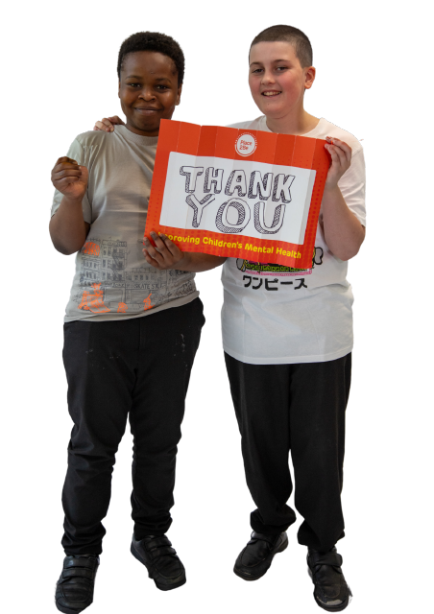
CALL TO ACTION
Invite one person you’ve never sat with to join you.
Interrupt exclusion once when you hear it.
Check in with someone who seems quieter at least twice this week.
Say your chosen number out loud to the person next to you and make a simple plan for when you’ll do it.

Slide 15

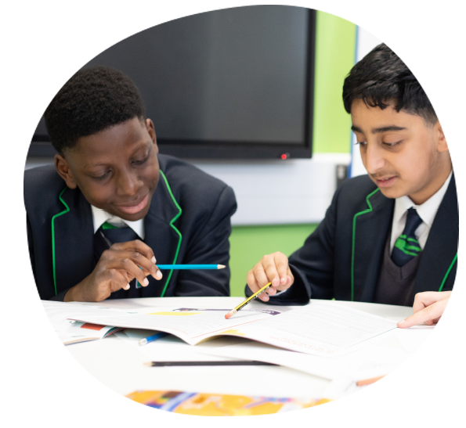
CLOSING
Belonging grows from ordinary choices: the name you use, the invite you offer, the time you give. Small actions add up and change what this school feels like. Choose one small action now and help make this place somewhere more people can belong.
THANK YOU!

