Slide 1
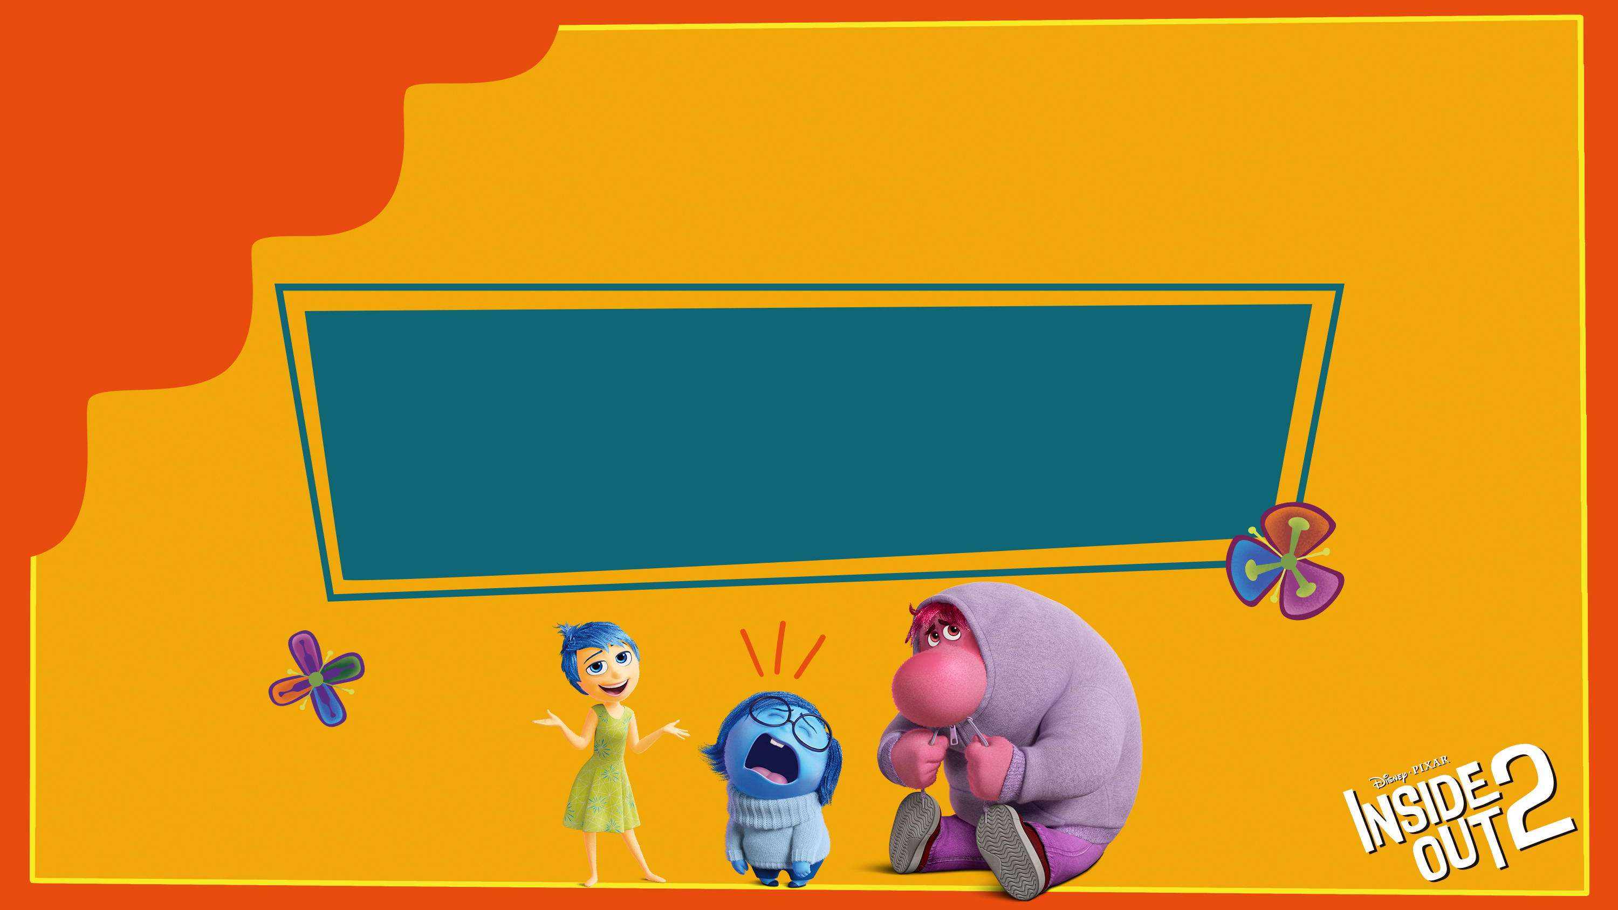

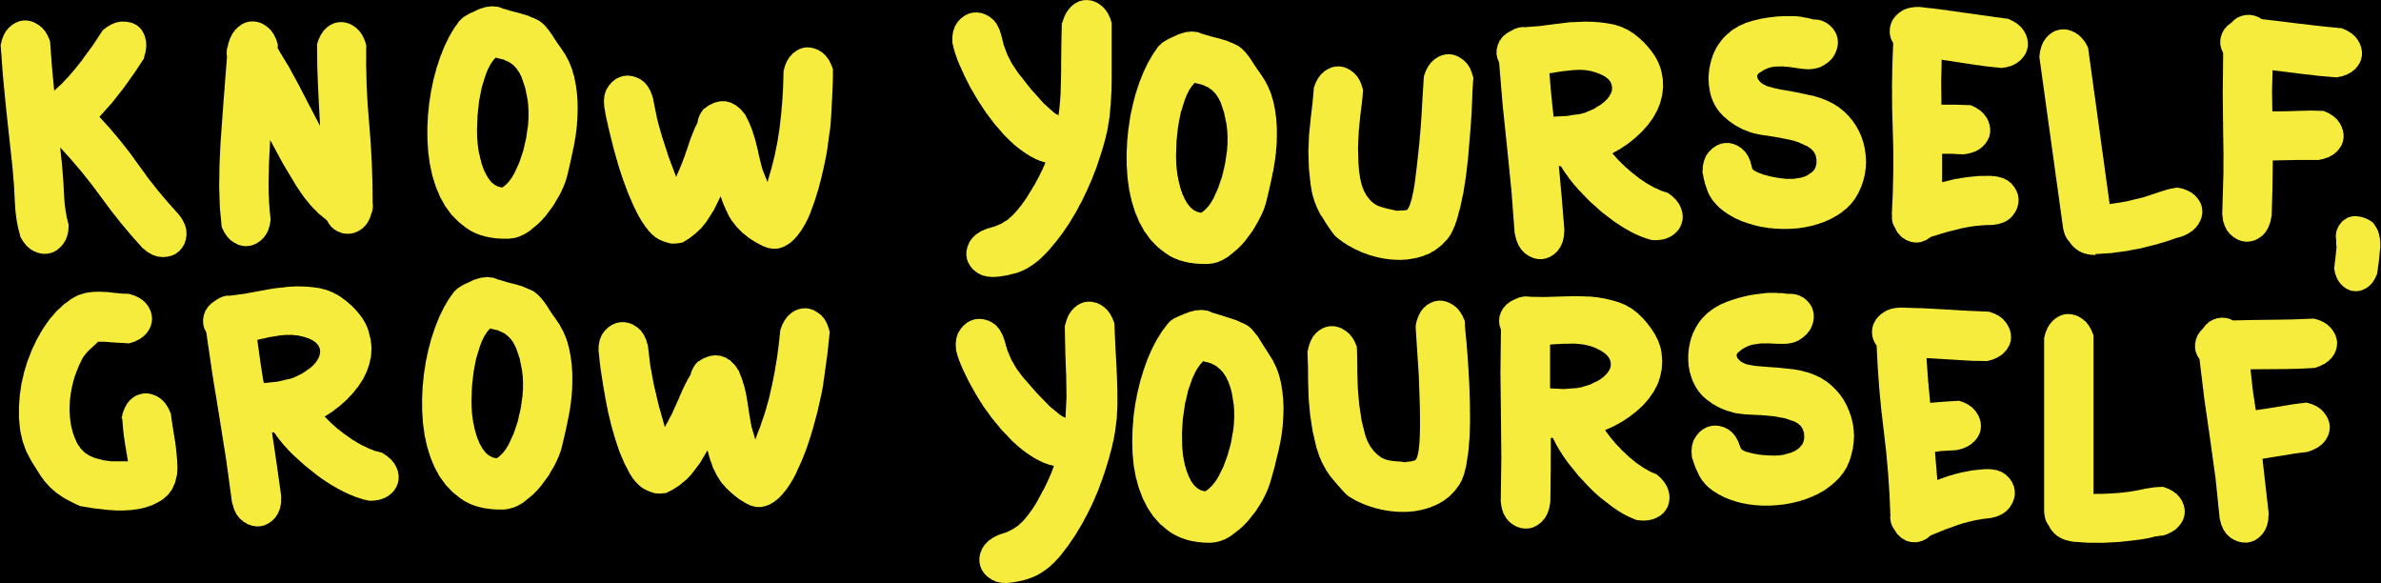
Notes:
Good morning/afternoon everyone. Today’s assembly has been inspired by Place2Be’s Children’s Mental Health Week. The theme this year is ‘Know Yourself, Grow Yourself.

Slide 2
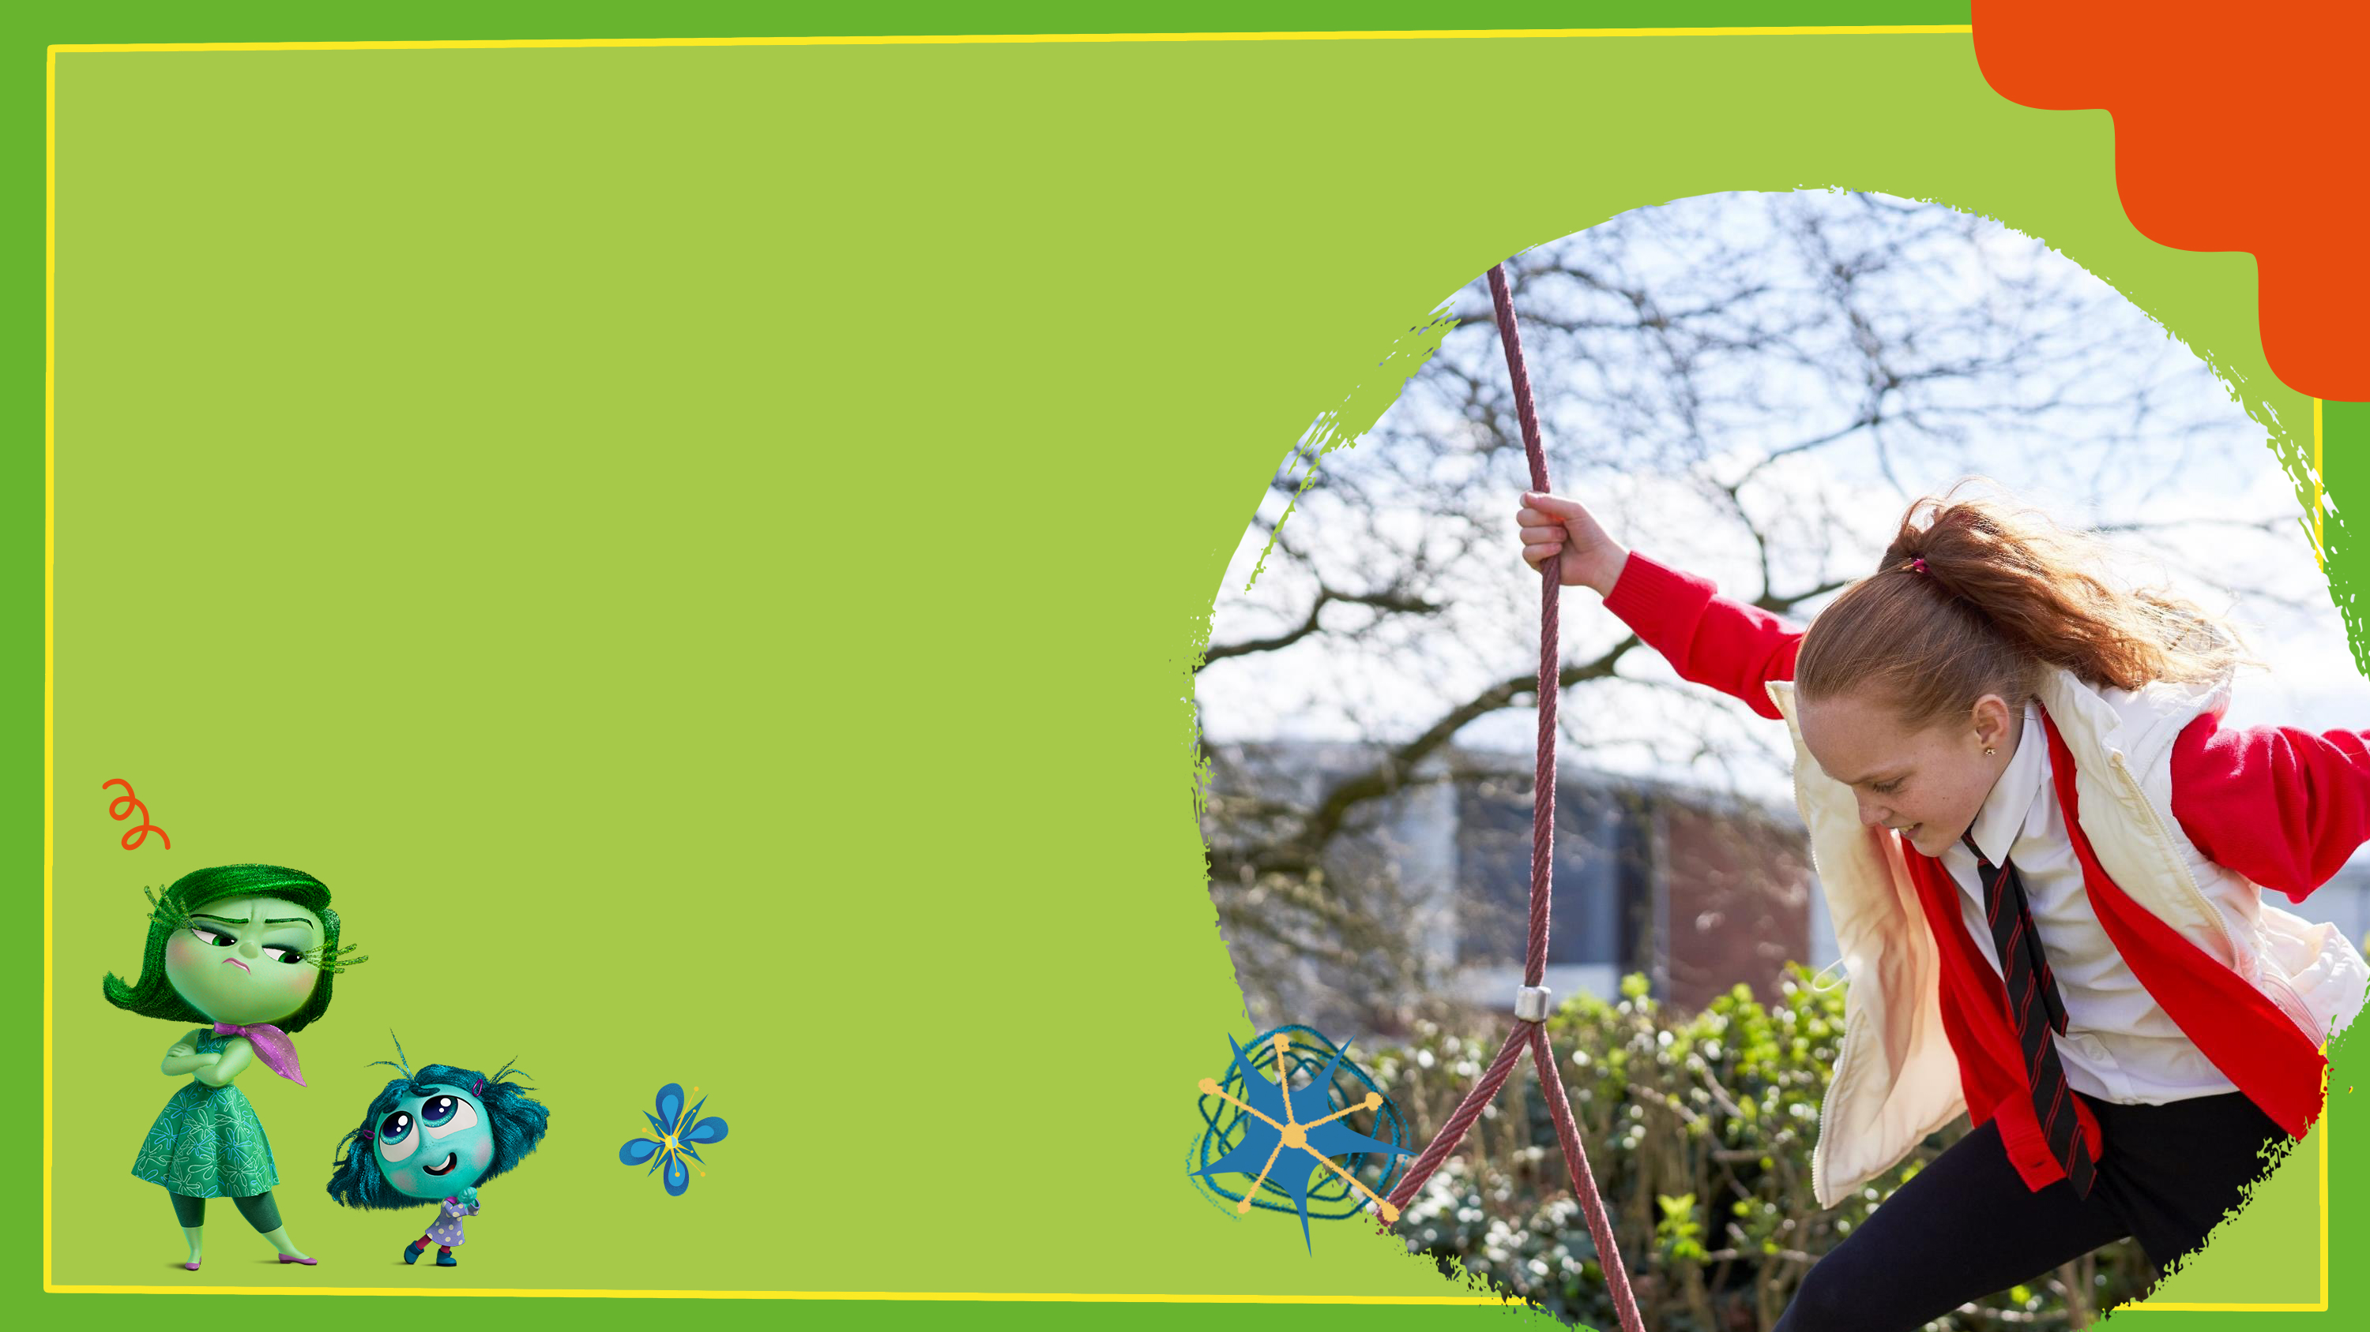

When we take notice of ourselves and how we feel, we are able to make better choices and be more connected with our feelings and behaviours.
Noticing these things can help us recognise when we need support.
What are some things we love doing, and what are others that fill us with fear or disgust?
Notes:
Think about the different emotions, especially those in Inside Out – joy, sadness, disgust? Can we think of a time they seemed really loud in our heads, and then times they were much quieter? What made that change?
It’s the scene where Sadness shyly asks Joy if she can go down into the memory pool with her. In response, Joy takes Sadness hand into hers and says to her friend, “Of course! Remember Sadness, wherever I go, you go too.”

Slide 3
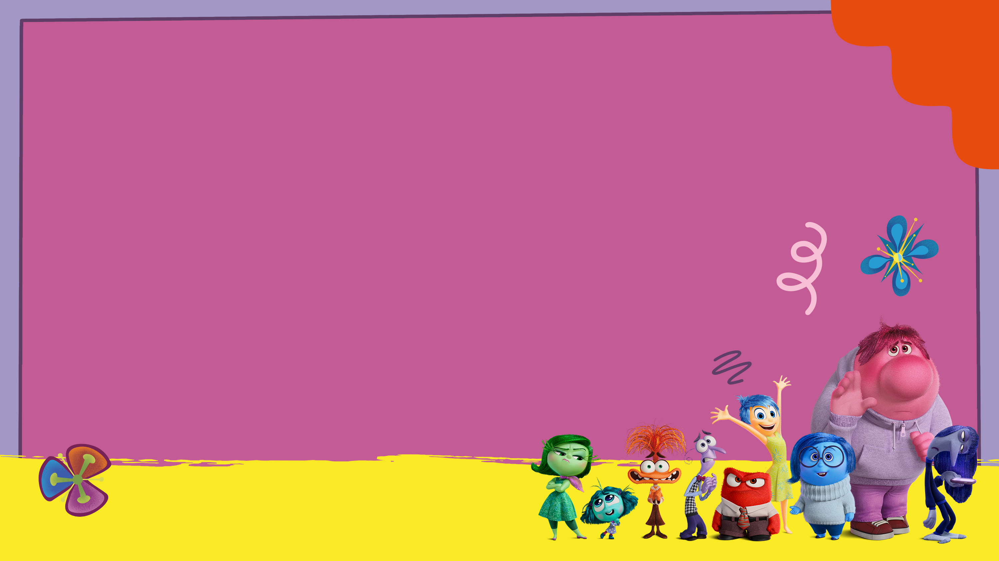
How well do we really know ourselves?
Sometimes we can feel like we are in the middle of a tussle of emotions
– feeling joy, then sad, angry and jealous, all at the same time!
In Inside Out, Sadness asks Joy if she can go down into the
memory pool with her.
Joy takes Sadness hand into hers and says to her friend, “Of course! Remember Sadness, wherever I go, you go too.”
These emotions help us to understand ourselves better – what we like and dislike, where we feel comfortable and where we are scared. Can you think of a time when you were happy and sad?

Slide 4
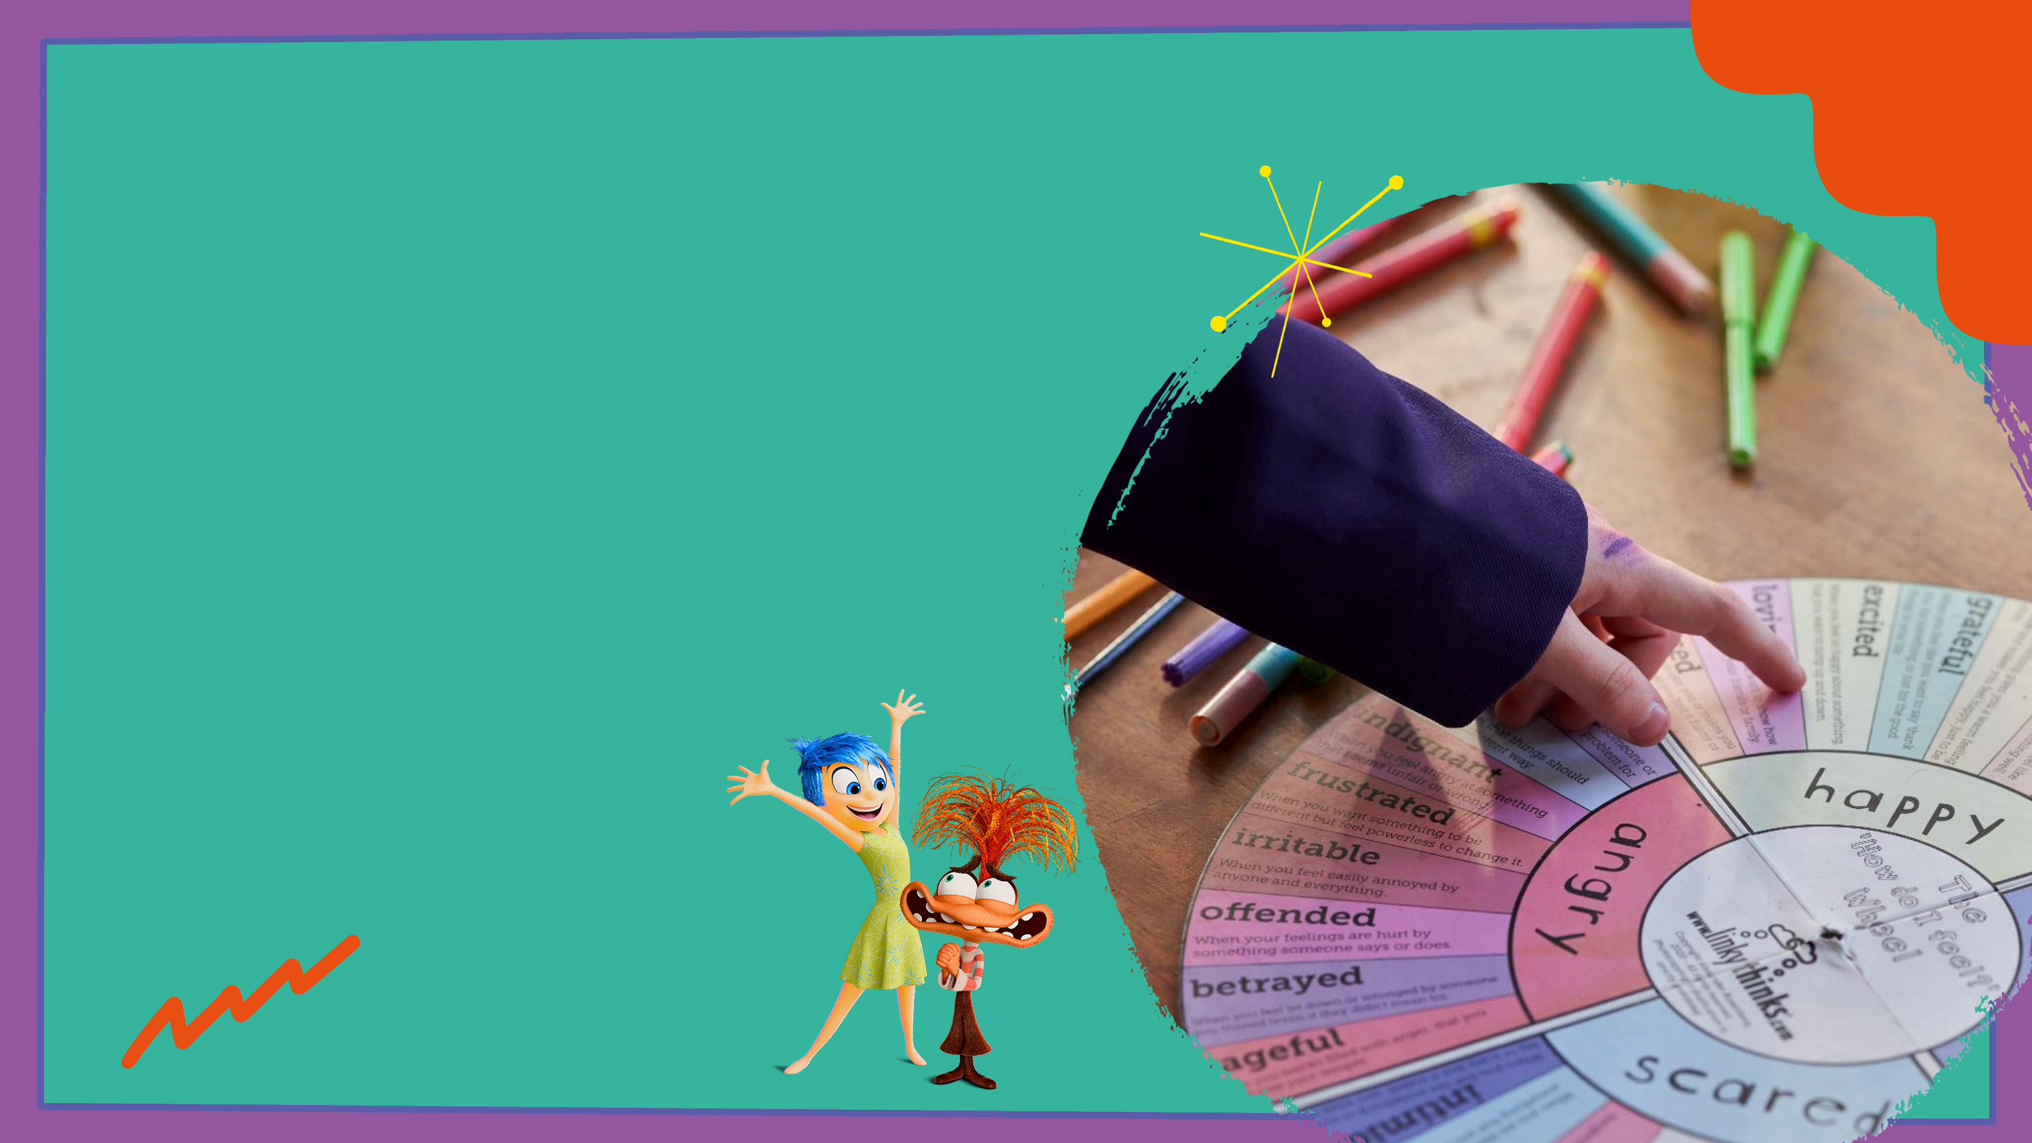
Children’s Mental Health Week Activity
There are parts of ourselves that we may not see as easily. Sometimes we can learn more about ourselves with the help of family, friends, and teachers.
What makes me feel sad and nervous?
What makes me feel joyful or happy?
What do I enjoy learning about?
What am I good at?
What makes me laugh?
Notes:
I want you all to imagine that you have a bag or a pocket that contains 5 very special heart shaped stones.
Each stone has a question within it – just for you. As I read each one, I want you to think quietly to yourself what the answer may be.

Slide 5

Getting to know yourself and each other is a wonderful way to grow, make connections and support others.
"The most important thing is to try to know yourself.“
— Socrates
“Promise me you’ll always remember you’re braver than you believe, and stronger than you seem, and smarter than you think.”
— Christopher Robin
“Every one of us needs to show how much we care for each other and, in the process, care for ourselves.”
— Princess Diana

