Slide 1
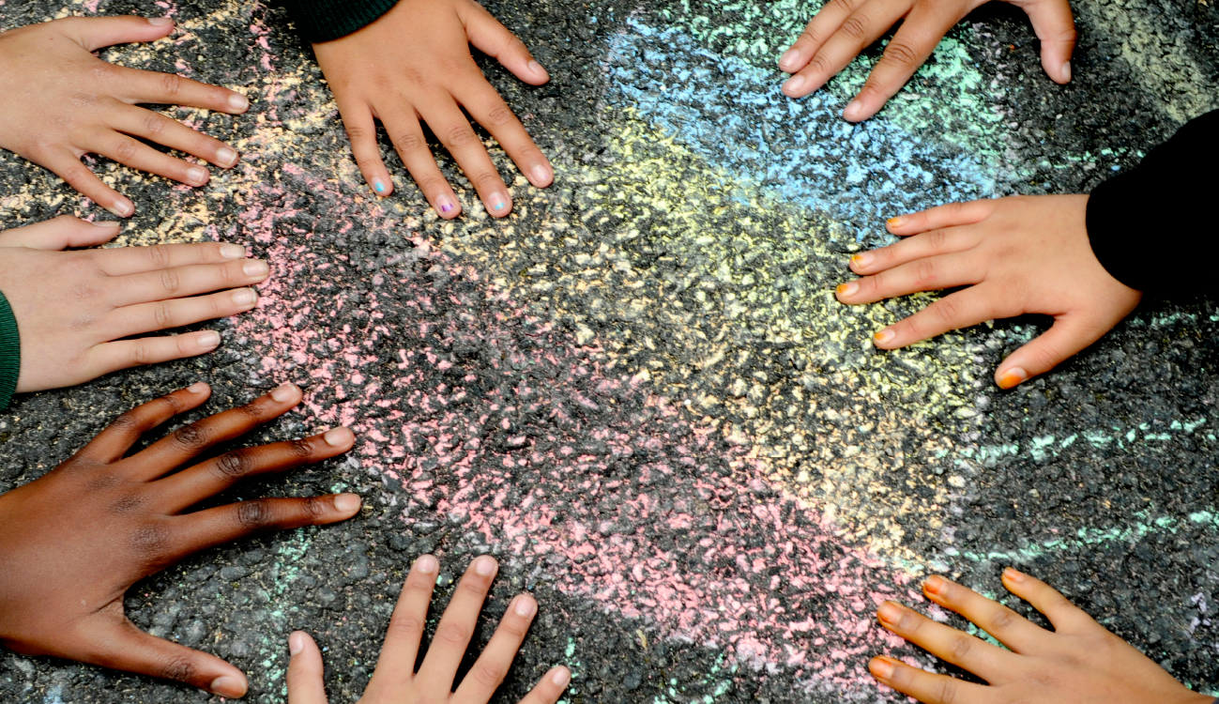






Assembly guide for primary schools 2026
Age 7-11
Notes:
Aim: To introduce children to the idea of This is My Place
You will need: Laptop / projector, story book to read

Slide 2


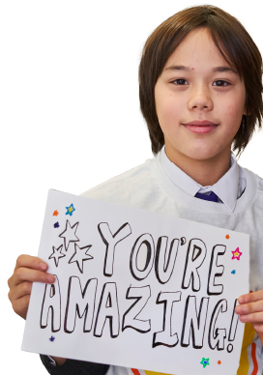


Hello and welcome:
Slide 1
Notes:
Suggestions of songs to play as children are coming into Assembly which some children and young people suggested:
Some Music suggestions from our CYP:
Everything is Awesome https://www.youtube.com/watch?v=StTqXEQ2l-Y
Hello Me and You https://www.youtube.com/watch?v=g9dVcZQBUdA
White Stripes We are going to be friends https://www.youtube.com/watch?v=PKfD8d3XJok
This is Me - The Greatest Showman https://www.youtube.com/watch?v=CjxugyZCfuw
We are Family - Sister Sledge https://www.youtube.com/watch?v=uyGY2NfYpeE
"My House" Matilda https://www.youtube.com/watch?v=bBU0y8-h1DQ
We Belong together We Belong Together
Kindness song Kindness by The Juicebox Jukebox - Be Kind Kids Song Childrens Music New World Kindness Day

Slide 3

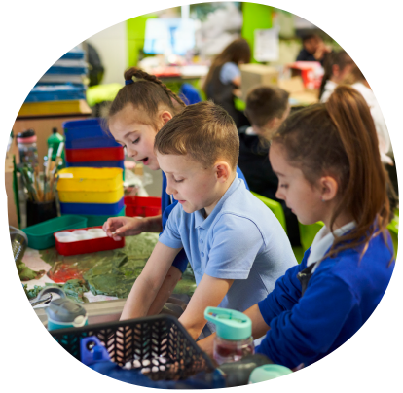

Today’s assembly has been inspired by Place2Be’s Children’s Mental Health Week. The theme this year is ‘This is My Place’ which is based around belonging and how we can feel a sense of belonging and help others feel like they belong.
Slide 2

Slide 4


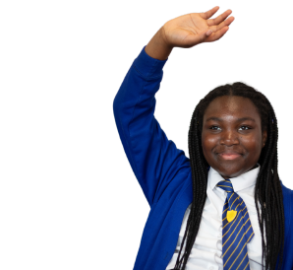

SO WHAT DOES BELONGING MEAN?
Slide 3
Notes:
Ask the children to raise their hands.

Slide 5

HERE’S WHAT SOME CHILDREN
AND YOUNG PEOPLE SAID TOO:
‘It’s like a place, your home, you belong with your family and friends’
‘Feeling included, not left out’
‘It's all about feeling safe’
‘Feeling a part of something’
‘Feeling like there are people similar to you as well as different’
‘Feeling like you fit in and feeling comfortable’
Remember you belong wherever you feel loved and
accepted for who you are. Just like at our school we hope.
We are all here to help if you don’t feel this way.
Slide 4

Slide 6

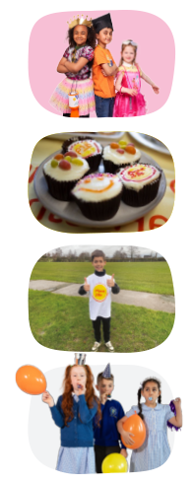
A FEW IDEAS FROM PLACE2BE:
Be your true self. Belonging comes from being accepted for who you are.
Do the things you love: sport, video games, music, crafts, these are great ways to connect each other.
Be kind to yourself when you make a mistake, you don’t need to be perfect.
Listen to your feelings and try to think about what you need.
Talk to someone you trust, you are not alone.
Slide 5

Slide 7
STORY:
Maya moved to a new town and sat alone at lunchtime, watching groups laugh and play. She liked drawing comics but felt too shy to show them. One day, Ben noticed Maya sketching and asked, “What are you drawing?” Maya shrugged and offered him a page. Ben grinned and showed it to two friends, who asked if Maya could teach them how to draw a hero. They sat together the next day with paper and pencils, taking turns and laughing when the superhero's cape kept getting tangled. Maya felt her cheeks warm in a good way — not because she changed who she was, but because someone had noticed and invited her in. Over the week, more kids came to learn, and the drawing circle became a place where new ideas were celebrated. Maya still drew the same comics, but now she did it with a team, and the playground felt a little more like home.
Slide 6
Notes:
(you may have your own or a story from one of the children)
(you may have your own or a story from one of the children)
Belonging means being noticed and welcomed.
Belonging means it is safe to be yourself.
Belonging happens when someone shows kindness.
Belonging is not making someone copy everyone else. It is about letting people join as they are.

Slide 8

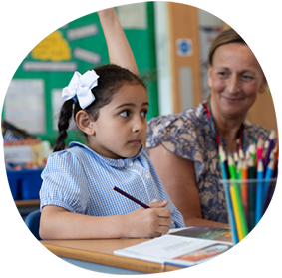
HOW CAN WE HELP OURSELVES TO FEEL WE BELONG
Top Tips from other Children:
Playing games with friends
Finding a place where you feel valued and welcome or people that
make you feel this way
Doing things we enjoy
Having an adult to talk to when not happy
By talking to people about feelings
Being around people you enjoy being with
Slide 7
Notes:
Can we think of any more?
Option for hands up and to take some answers

Slide 9
HELPING OTHER CHILDREN FEEL THEY BELONG
Top Tips from other Children:
‘If you see someone left out then you can ask them to play’
‘Be kind’
‘By asking people how they are and if they are okay.’
‘Make sure everyone has friends and feels included’
‘Put yourself in other’s shoes’
"Be somebody who makes everybody feel like a somebody"
Brad Montague, the creator of the popular online series Kid President
Slide 7
Notes:
Can we think of any more?
Option for hands up and to take some answers

Slide 10
A FEW IDEAS FROM PLACE2BE:
Be your true self. Belonging comes from being accepted for who you are.
Do the things you love: sport, video games, music, crafts, these are great ways to connect each other.
Be kind to yourself when you make a mistake, you don’t need to be perfect.
Listen to your feelings and try to think about what you need.
Talk to someone you trust, you are not alone.
Slide 5

Slide 11

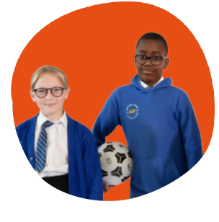
LET'S PRACTICE
Interactive activity
1. Turn to the person next to you and say
your name clearly.
2. Tell them your favourite colour or favourite game.
3. Swap so they say their name and favourite thing to you.
4. After pairs finish, everyone quietly wave to the person
you spoke with.
Slide 8

Slide 12
LET'S SING
Choose one of our songs to play and sing along to
or one that you or the children have chosen
"Everything is Awesome" The LEGO Movie
"Hello Me and You" The LEGO Movie 2
"We are going to be friends" White Stripes
"This is Me" The Greatest Showman
"We are Family" Sister Sledge
"We Belong together" Toy Story 3
"Kindness song" The Juicebox Jukebox - Be Kind Kids Song Childrens Music New World Kindness Day
Slide 9
Notes:
Let the children decide which is their favourite

Slide 13
CALL TO ACTION
This week, everyone pick one thing to try:
Say hello to one person you don’t usually talk to.
Share a toy, crayon, or turn in a game.
Invite someone to join your group.
Say out loud which one you will try.
Slide 10

Slide 14
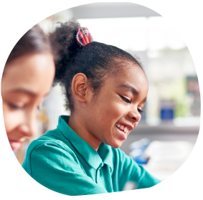
CLOSING
Remember Maya and Ben. Small, friendly actions make big changes. If each of us does one kind thing, our classroom and playground will be a place where everyone feels they belong. Thank you.
Thank you!
Slide 11

