Slide 1

Assembly guide for secondary schools 2027
KS3/KS4, S1-S6 (Scotland)
Notes:
Aim: To introduce children to the idea of Step into Our World
You will need: Laptop / projector, story book to read

Slide 2
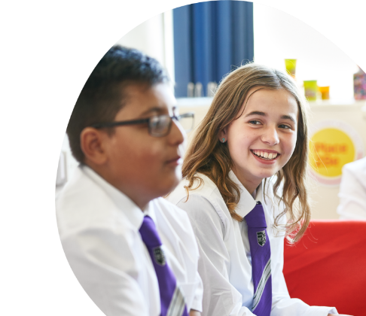
Welcome
Slide 1
Notes:
Suggestions of songs to play as children are coming into Assembly which some children and young people suggested:
Some Music suggestions from our CYP:
People Help the People by Birdy
White Stripes We are going to be friends
This is Me - The Greatest Showman

Slide 3
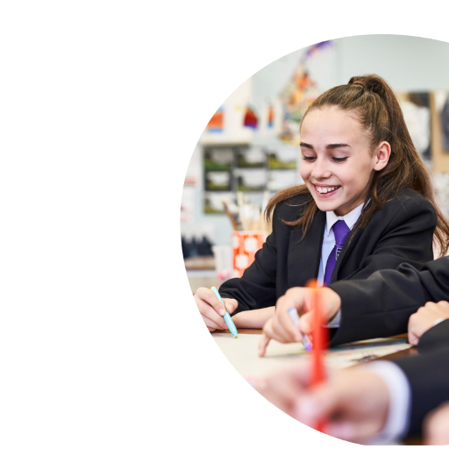
Today’s assembly has been inspired by Place2Be’s Children’s Mental Health Week. The theme this year is ‘Step into Our World’ which is based around empathy and nurturing relationships.​
Slide 2

Slide 4
SO WHAT IS EMPATHY?
Step Into Our World is all about empathy and nurturing our relationships. It encourages us to see things from a young person’s point of view. The aim is to help us understand how young people feel, what they think, and what they experience.​
Positive and caring relationships are so important for young people’s wellbeing. Support from parents, carers, family members, teachers, friends, and the wider community helps young people feel safe, confident and valued.​
Slide 3

Slide 5
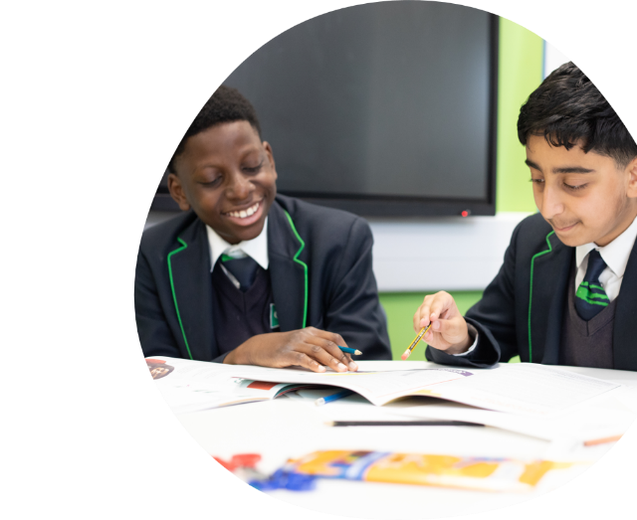
WHY EMPATHY MATTERS
Empathy reminds us that while we may not share the same experiences, we can still seek to understand and support one another.​
It helps us build healthy relationships with others.​
Slide 4
Notes:
Ask the pupils to raise their hands.

Slide 6
Making sure that everyone feels they are being listened to and understood is very important to us at this school. ​
Some young people at Place2Be schools thought of some ideas of what schools could do to help them feel an adult was being empathetic - that they were being listened to.
Here are a few examples:
TOP TIPS FROM OUR YOUNG PEOPLE:
“Listening to me and not making me feel like everything I say is wrong”
“Try to understand and be open minded”
“Ask students if they are ok”
“Being calm​”
“Let me talk and have my own voice and they let me know that my feelings are valid​”
“That life is becoming more complex just because we have better resources and technology doesn't make life easier”
“We are a new generation and shouldn't be forced to live like another generation”
Slide 5

Slide 7
A FEW IDEAS FROM PLACE2BE
Be Curious
we are all different and so sometimes what you might think about someone might not be the same until you talk to them. ​
Listen
to what someone is saying to you so you can understand how they might be feeling.
Imagine
putting yourself in someone else’s shoes - how or what would you feel.​
Slide 6

Slide 8
RESOURCE LINK
Use the following resource to watch and discuss:
Not About The Nail - Written and directed by Jason Headley
https://www.youtube.com/watch?v=-4EDhdAHrOg
Empathy doesn't mean having all the answers. Sometimes making someone feel heard and understood is enough.
Discuss:
What is the difference between listening to understand and listening to solve a problem?
Why might someone want us to understand how they feel before offering advice?
How can we check what someone needs instead of making assumptions?
Slide 7
Notes:
This film Not About the Nail What is explores a situation when someone shares a problem or difficult feeling, our first instinct can be to offer advice or try to solve it. Sometimes, however, what the person needs first is simply to feel heard, understood and supported.
It can help pupils explore:
Listening without immediately trying to fix things
Recognising that someone may need empathy rather than advice
Trying to understand a situation from another person's perspective
Paying attention to what someone needs from us, rather than assuming we know
Understanding that we can see an obvious solution but the other person's feelings are still valid

Slide 9
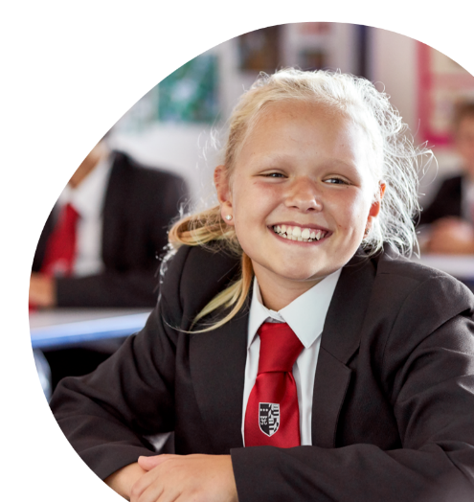
LET'S TRY THIS OUT
Turn to the person next to you.​
Ask them their name and what makes them happy​.
Now you have listened to that person, you know a bit more about them.​
Slide 8

Slide 10

CLOSING:
Remember we don't always know how someone else is feeling. Empathy means taking a moment to understand another person's experience and thinking about how we can help.​
Thank you

