Slide 1
Notes:
Good morning/afternoon everyone. Today’s assembly has been inspired by Place2Be’s Children’s Mental Health Week. The theme this year is ‘Know Yourself, Grow Yourself.

Slide 2
“If you are able to look yourself in the mirror every day with the decisions that you make, that's where power starts.”
Selena Gomez

Slide 3
How well do we really know ourselves?
Notes:
Our thoughts, feelings and actions can often surprise us and those around us. Do we show our true selves to others? It’s important to consider the impact of peer pressure, societal expectation and social media when asking yourself this question.

Slide 4
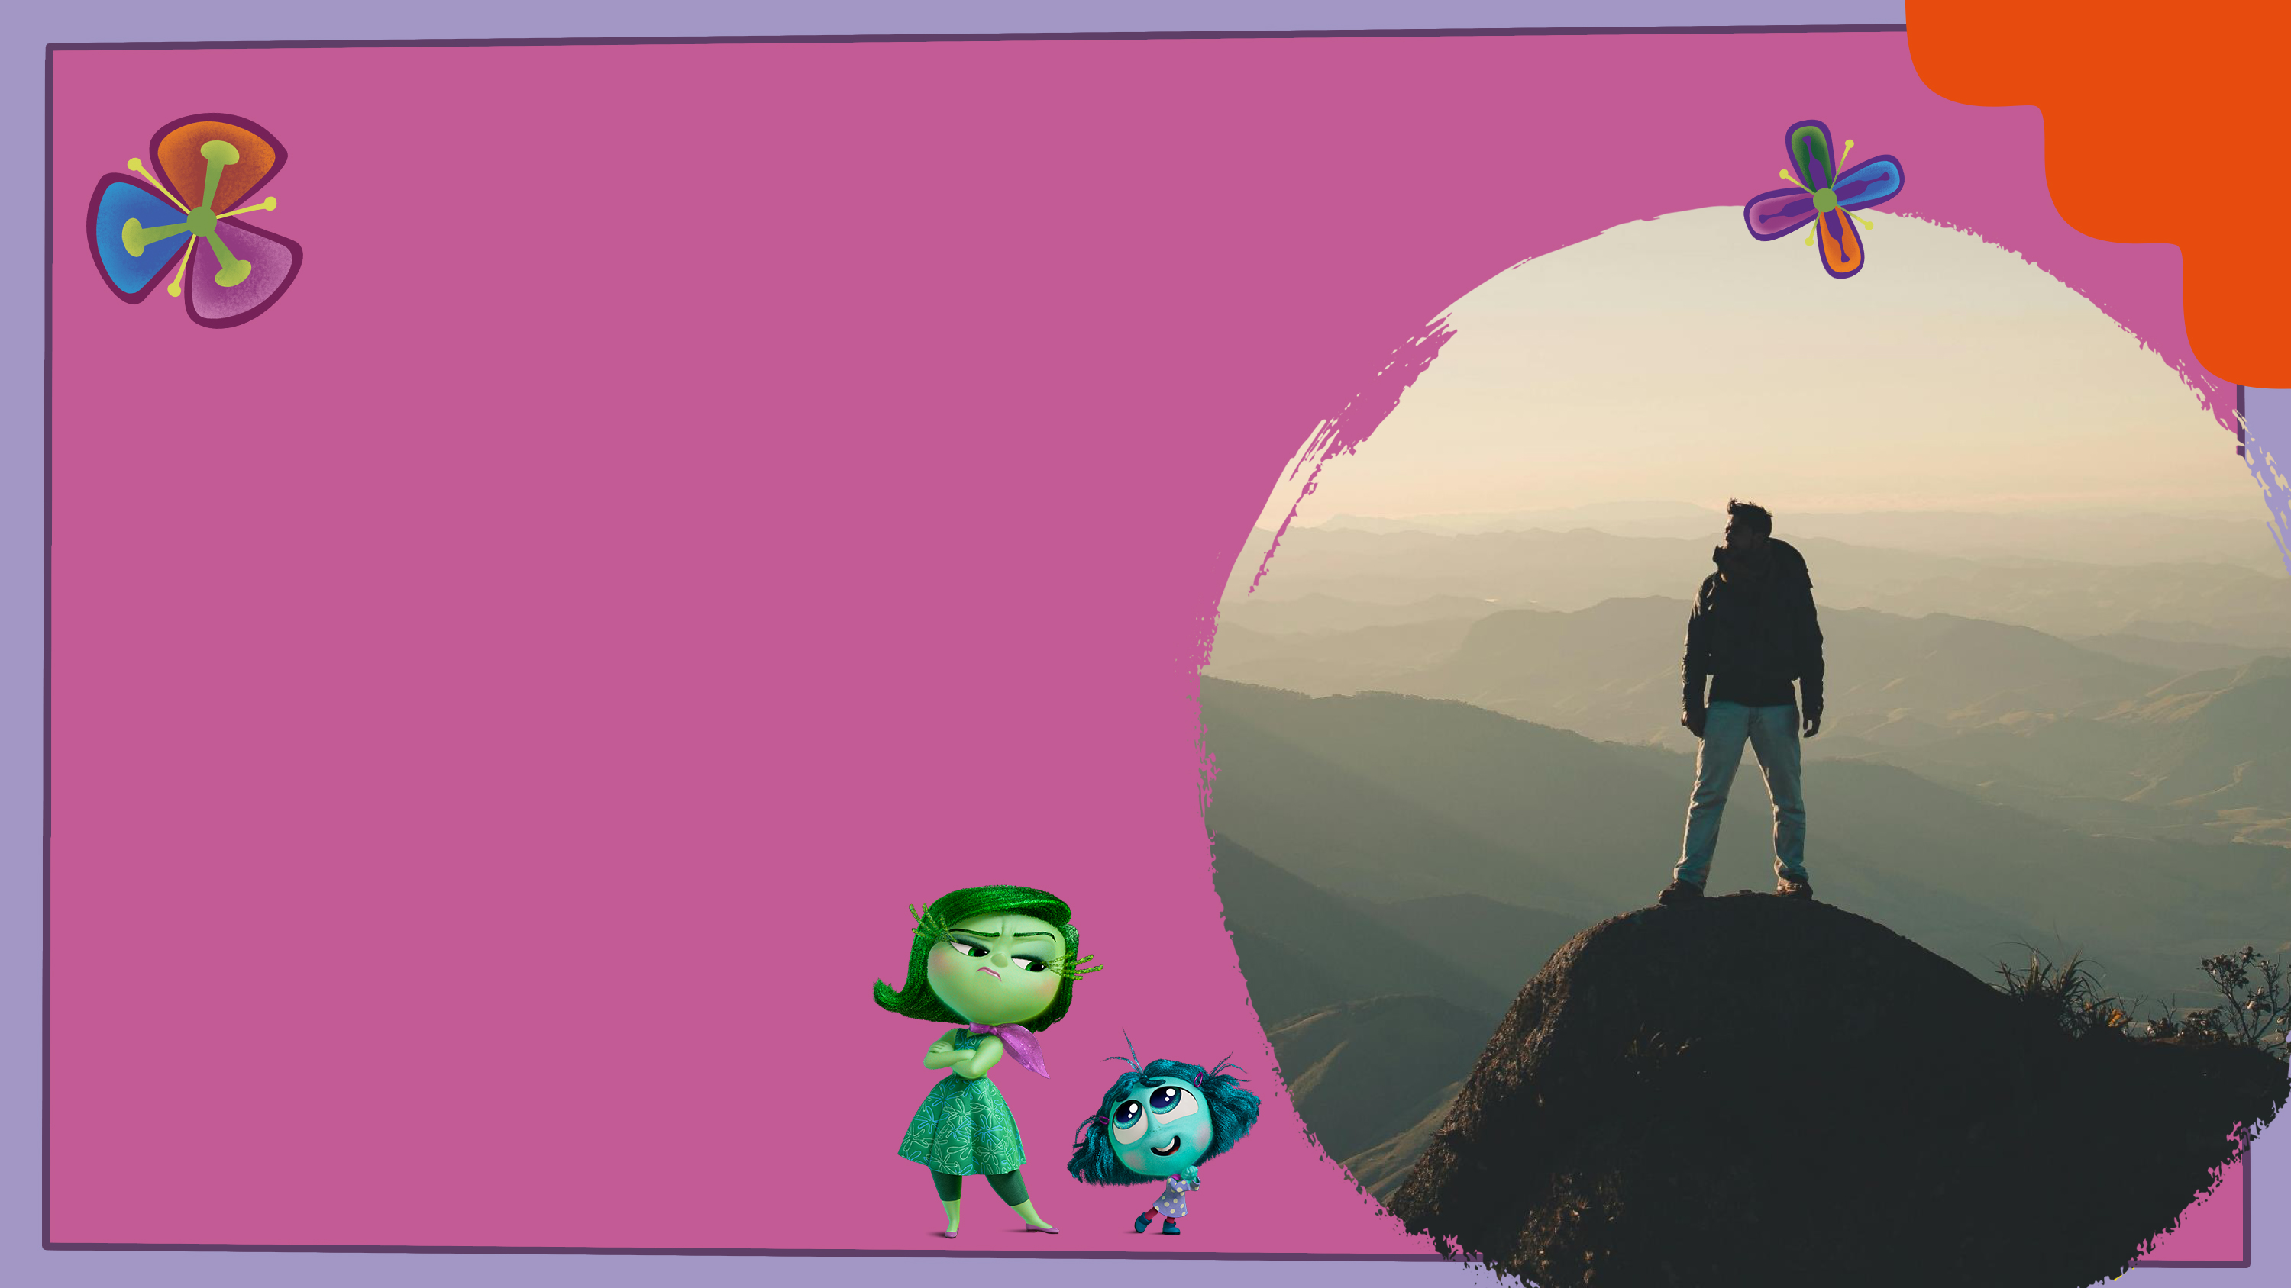
By being curious about ourselves and noticing what’s going on, we can make better choices and be more in touch with our feelings and behaviours.
Notes:
Self-awareness can help us recognise what is driving our thoughts and actions, which can give us more control over how we respond.

Slide 5
Children’s Mental Health Week Activity
What makes me feel nervous?
What makes me feel relaxed?
What do I enjoy learning about?
What am I good at?
What makes me laugh?
Notes:
I want you all to imagine that you have a bag or a pocket that contains 5 very special heart shaped stones.
Each stone has a question within it – just for you. As I read each one, I want you to think quietly to yourself what the answer may be.

Slide 6
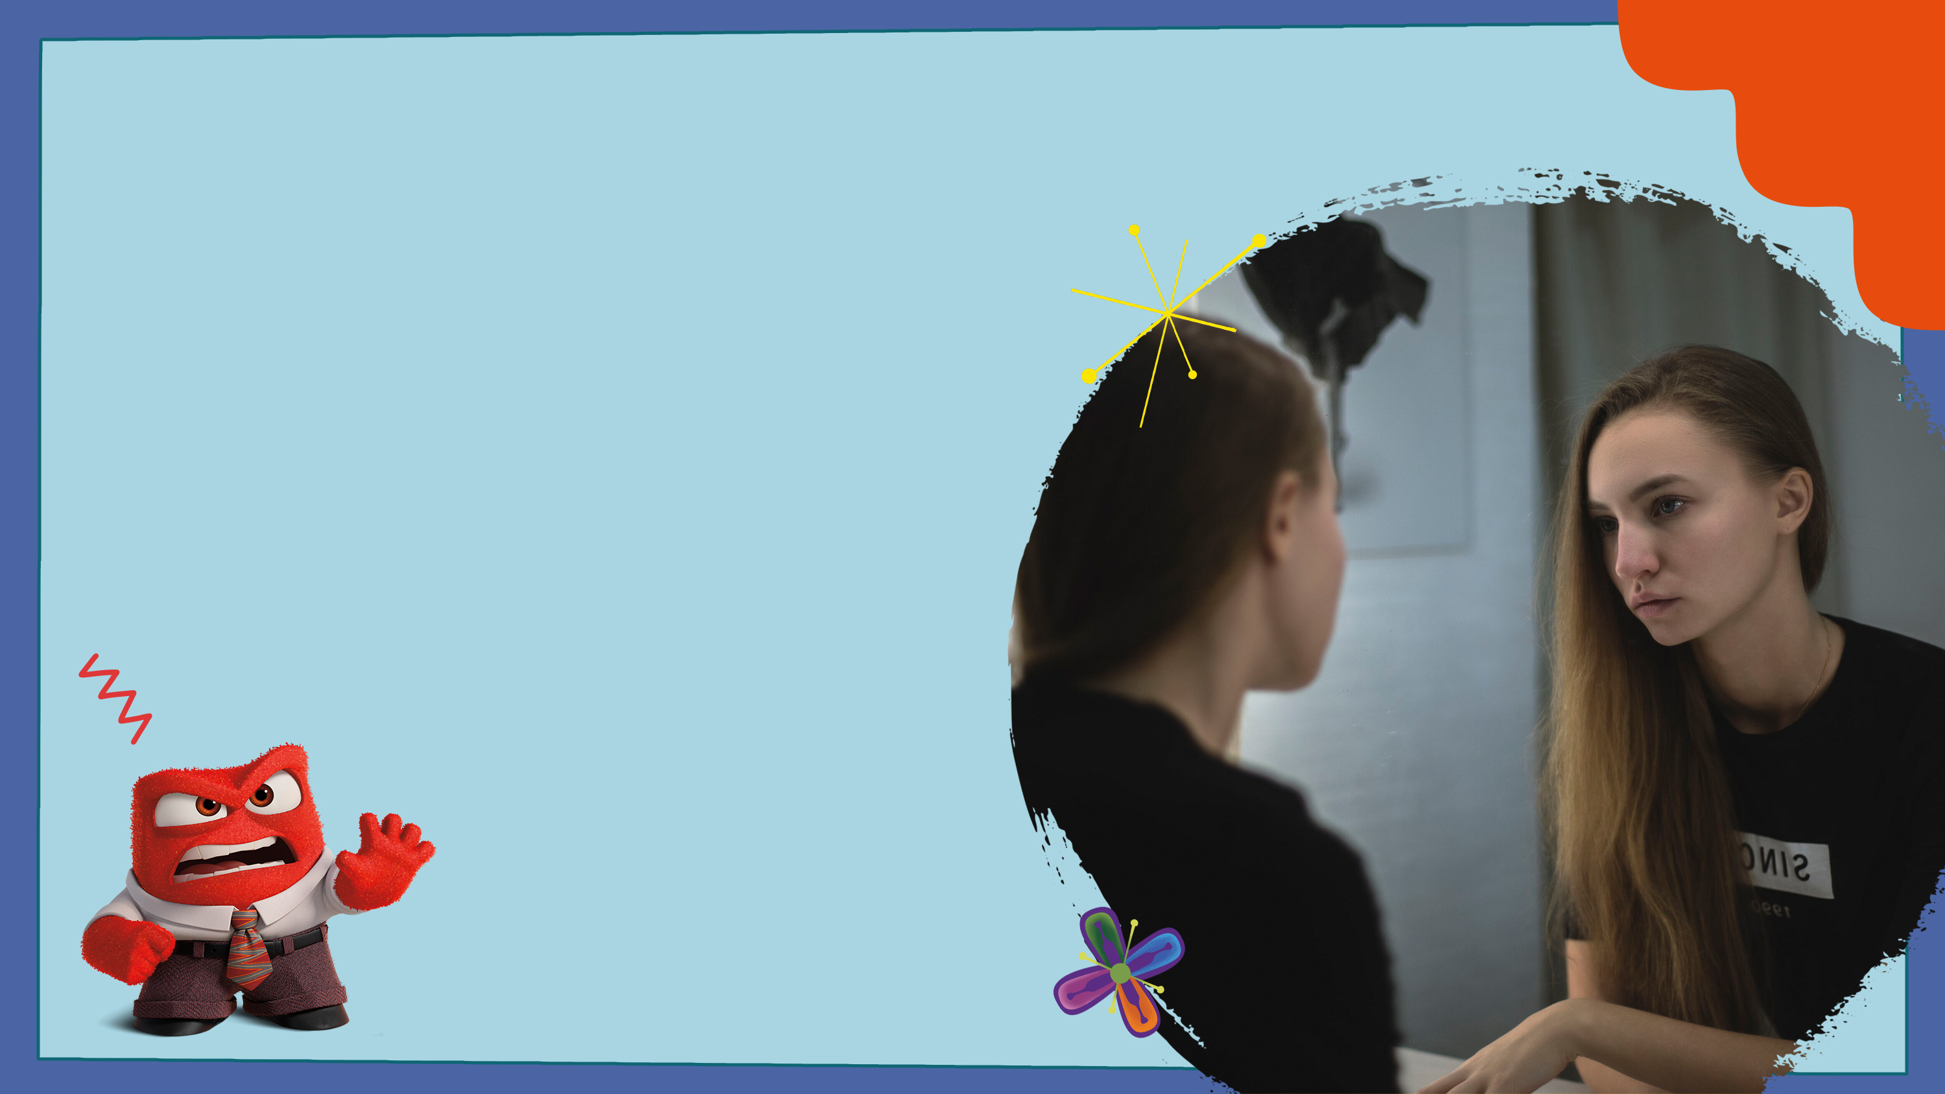
What would a best friend or a family member say about you, what might others notice that you don’t always see?
Notes:
Sometimes we can learn more about ourselves with the help of others. We may not see parts of ourselves as easily, so feedback from friends, family and teachers can help us find out.
What would a best friend or a family member say about you, what might others notice that you don’t always see? Encourage students to reflect on this question.

Slide 7
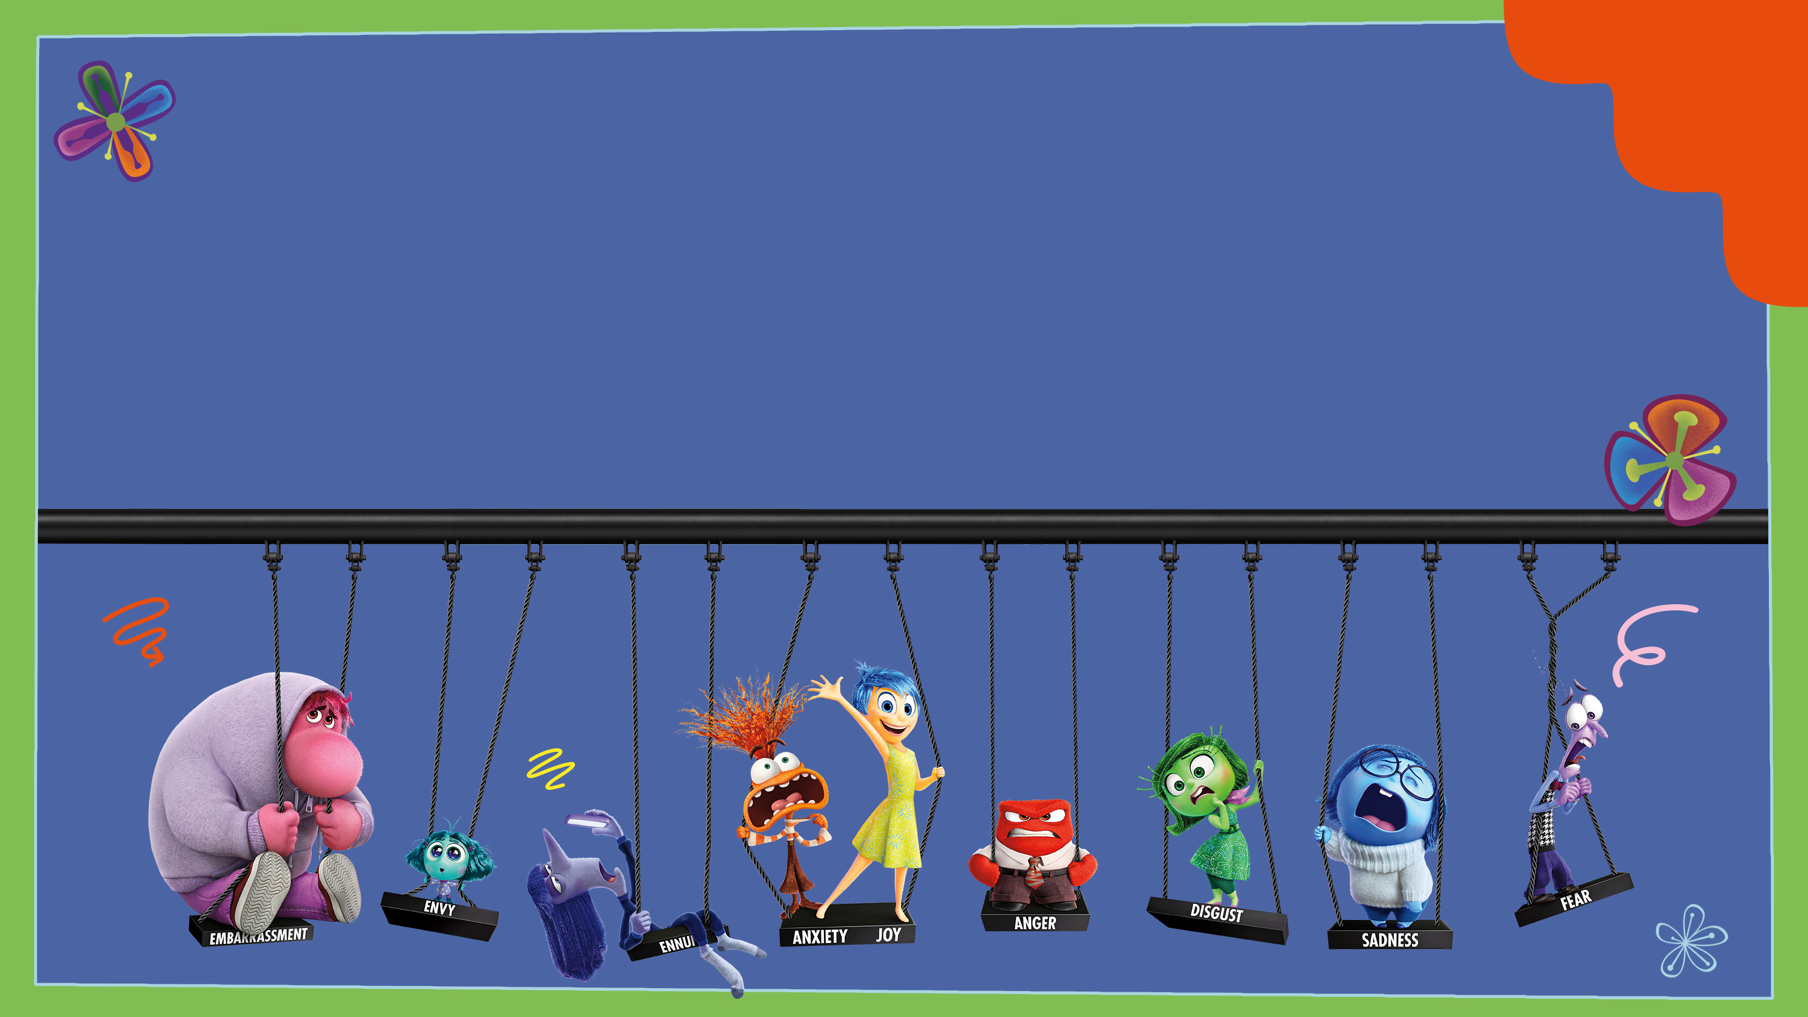
“If you are always trying to be normal, you will never know how amazing you can be”
Maya Angelou

