Slide 1




Assembly guide for primary schools 2027
EYFS/KS1, Nursery-P3 (Scotland)
Notes:
Aim: To introduce children to the idea of Step into Our World.
You will need: Laptop / projector, story book to read

Slide 2


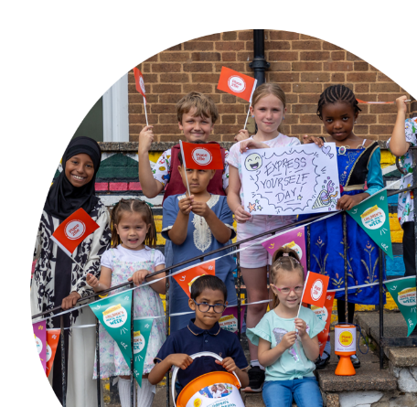

Hello and welcome
Slide 1
Notes:
Suggestions of songs to play as children are coming into Assembly which some children and young people suggested:
Some Music suggestions from our CYP:
Everything is Awesome https://www.youtube.com/watch?v=StTqXEQ2l-Y
Hello Me and You https://www.youtube.com/watch?v=g9dVcZQBUdA
White Stripes We are going to be friends https://www.youtube.com/watch?v=PKfD8d3XJok
This is Me - The Greatest Showman https://www.youtube.com/watch?v=CjxugyZCfuw
We are Family - Sister Sledge https://www.youtube.com/watch?v=uyGY2NfYpeE
"My House" Matilda https://www.youtube.com/watch?v=bBU0y8-h1DQ
We Belong together We Belong Together
Kindness song Kindness by The Juicebox Jukebox - Be Kind Kids Song Childrens Music New World Kindness Day

Slide 3

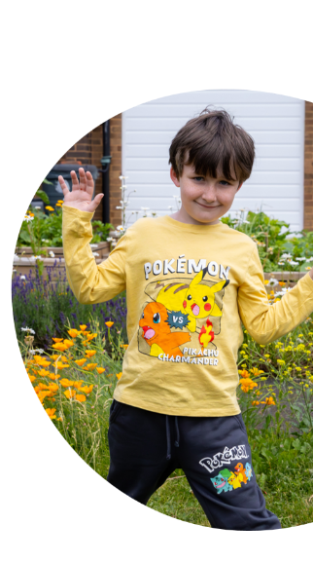


Today’s assembly has been inspired by Place2Be’s Children’s Mental Health Week. The theme this year is ‘Step into Our World’ which is all about understanding how someone else is feeling.
Slide 2

Slide 4


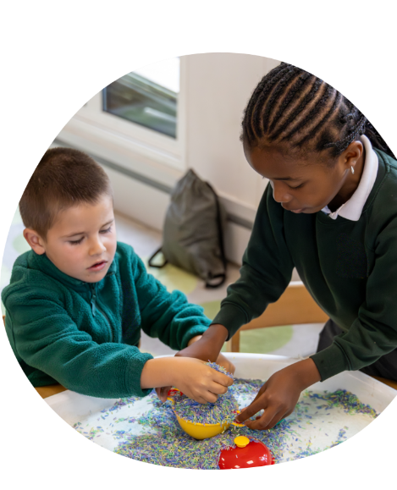


SO WHAT DOES EMPATHY MEAN?
Slide 3
Notes:
Ask the children to raise their hands.

Slide 5

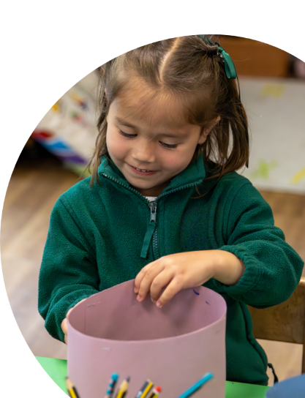



WHAT IS EMPATHY
Empathy means being able to step into someone else's world and understand what they might be feeling.
Slide 4

Slide 6






WHAT CHILDREN SAY THEY NEED FROM ADULTS
“Talk about something different to make me feel happy.”
“They can give us a chat and ask why we are sad.”
“Having the space we need to understand how we feel.”
Slide 5

Slide 7



STORY: A NEW FRIEND IN CLASS
Mila's First Day
Today is Mila's first day at school. She doesn't know anyone in the class. At playtime, she stands quietly by herself and watches the other children playing together.
Sam notices Mila is looking sad and wonders what might be wrong. Then he thinks how he would be feeling if it was his first day at a new school.
So, he walks over to Mila and asks "Would you like to play with us?" Mila smiles and joins the game.
Discussion Questions
How do you think Mila felt when she arrived at school?
What clues tell us how she was feeling?
How do you think Mila felt when Sam invited her to play?
Slide 6

Slide 8


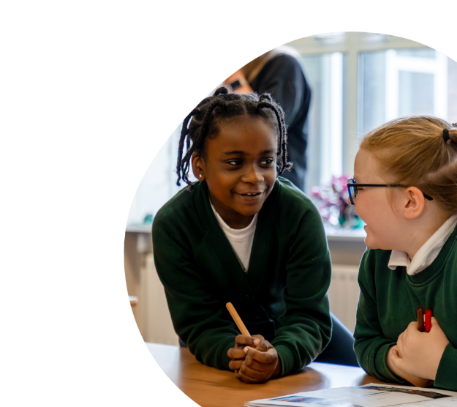

LET'S PRACTICE
Emotion detective!
Turn to the person next to you and say your name clearly.
Tell them what makes you feel happy.
Swap so they say their name and what makes them feel happy to you.
Now you can report what makes that person feel happy.
Slide 7

Slide 9


LET'S SING
Choose one of our songs to play and sing along to or one that you or the children have chosen.
Count on Me – Bruno Mars
You've Got a Friend in Me – Randy Newman (Toy Story)
This is Me – The Greatest Showman
Slide 8

Slide 10




CALL TO ACTION
This week, be an empathy hero.
Can you:
👂 Listen carefully when someone is talking.
😊 Notice how others might be feeling.
🤝 Include someone who is on their own.
💬 Use kind words to help someone feel better.
❤️ Stop and think: "How would I feel if that happened to me?"
Slide 9

Slide 11





CLOSING:
Remember we don't always know how someone else is feeling. Empathy means taking a moment to understand another person's experience and thinking about how we can help.
Thank you

